Slide 1
The Kinda-ish Final Project
By Robert Judka
PS – please have mercy on me

Slide 2








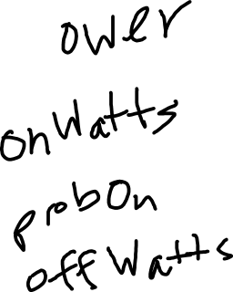
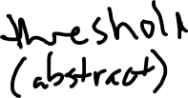






Slide 3
Test Case | Output | Tested?
List all appliances in a specific location | List all appliances in of a single location | ✔
List all appliances of a specific type | List all appliances that are either smart or not smart, user decides | ✔
Wattage warning level = 500,000; total wattage of all appliances is 200,000 | No changes to power grid | ✔
Wattage warning level = 50,000; total wattage of all appliances is 200,000 | After browning out and turning smart appliances off, total wattage of all appliances should be < 50,000 | ✔

Slide 4
The Greatest Algorithm Conceived!
Check if the total wattage of the power system is less than the wattage warning level
If not, turn off all smart appliances
Turning off smart appliances one by on sorted by wattage size could have worked, but this allowed me to brown out less rooms in the event that turning off all the smart didn’t put the total wattage below the wattage warning level
Also no where it never stated that turning the smart appliances to a low power state affected the functionality of the appliance, so it is no harm in trying to save the planet as well ☺
If turning off all smart appliances did not lower the total power below the wattage warning level, brown out the locations with the highest wattage appliances first
Even if the location with the highest wattage appliance could have no other high wattage appliances, I feel like it would be safer to shut off the most power-consuming appliances first

